Slide 1
CS 4350: Fundamentals of Software Engineering Lesson 3.1: Capturing User Requirements
Jonathan Bell, Adeel Bhutta, Ferdinand Vesely, Mitch Wand
Khoury College of Computer Sciences
© 2022 Released under the CC BY-SA license

Slide 2
Outline of this week’s lessons
TODO
TODO

Slide 3
Learning Goals for this Lesson
At the end of this lesson, you should be able to
explain why design is important
identify three different scales of design
for each of the scales:
be able to give examples of vocabulary words at each scale
TODO
Notes:
<read slide>

Slide 4
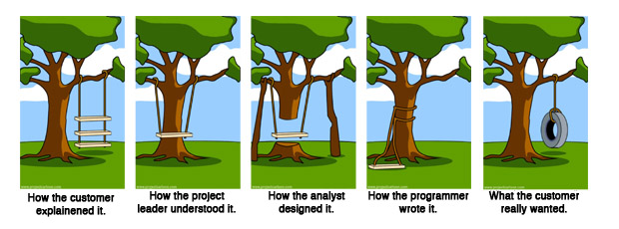
Overall question: How to make sure we are building the right thing
Requirements Analysis
Planning & Design
Implementation
Notes:
OK, so we have some typescript under our belts, we have some ideas of how to start to design our software, what is it that we are building, and how?
This meme does a great job capturing the many ways in which we can get off course, and end up building the wrong thing.
Ask students to raise hands if they have seen this meme before; it floats around in a variety of forms and surely someone has, this will be useful to point out on the next slide
Notice that we might as well call the panels:
(click to show the build) ”Requirements”, “Design”, “Implementation” – This week we are going to discuss this theme of “are we building the right thing” in each of these phases. In today’s lesson, we start at square one: how the customer explained it

Slide 5
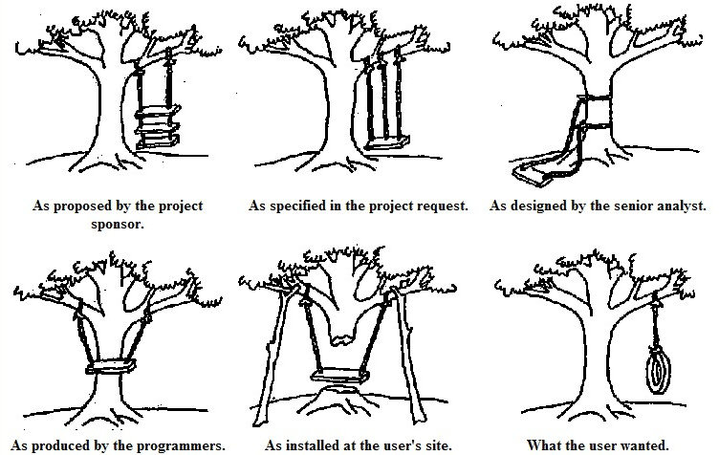
What has changed in the past 50 years?
History of the tire swing meme
Notes:
It may not be surprising that this meme dates back to at least the 1970’s, and long before the internet, was photocopied and hung up on the wall in many offices, particularly at software companies. These are not new problems: understanding what the customer wants the software to be, and then ensuring that we implement something that solves that problem is not easy. We’ll provide some historical context of how software was built between the 1960’s and today.
Throughout this historical journey, we will see that each approach had proponents who insisted that as long as some particular process was followed, success was surely guaranteed. Using the power of hindsight, we’ll try to tease apart some best practices that work better than others, and more importantly, under what contexts you might want to try each approach

Slide 6
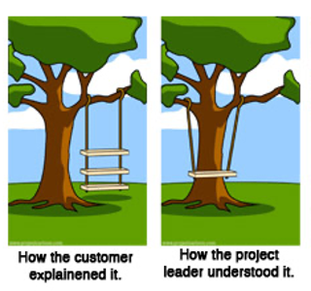
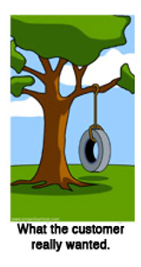
Why is requirements engineering hard?
Problems of understanding
Do users know what they want?
Do users know what we don’t know?
Do we know who are users even are?
Problems of scope
What are we building?
What non-functional quality attributes are included?
Problems of volatility
Changing requirements over time
6
Notes:
Consider right now an example developing of a virtual meeting platform. With the start of the COVID-19 pandemic, and shift to virtual meetings, there has been an enormous demand for software to help substitute for physical events. But, even today, two years into this, many platforms still don’t provide the experience that users want: how do you replace some physical interactions with a software product? These kind of challenges come up all of the time in software projects.
Sometimes, clients want to bring software in to solve some problem that is currently not being addressed, but don’t know exactly how to solve it. In other times, new software is brought in as a technology to improve an existing process. There is a way that things are done, and your software is going to help that get done better. In those situations, the client may simply not know what will work best for them.
Software engineering aims to provide answers, or at least a framework for answers to these questions
Examples of problems of understanding corresponding to the bullets:
What they want? -> Simply don’t know what is possible, won’t know it until they see it, often know what the problem is that they want the software to solve, but not the solution. Coming up with the solution is a design problem. Good to have a buddy who is a user experience designer.
What we don’t know? -> Most software is not “general purpose”, but exists within some domain.
Who are our users? -> Maybe most common in startups, where you have a client (moneybags investors) who are guessing who your users will be and what they want
Scope - What are we building? -> How to agree with client on a statement of work that is feasible given constraints, how to make sure that we stay on track?
Scope – quality attributes -> How to specify things like performance, usability, maintainability, security, etc
Volatility -> Long projects subject to changes in world around them

Slide 7

Soliciting Requirements
Option 1: Users tell developers what they want
Client determines the problem and the solution
Requirements might be formally provided in the form of a contract or statement of work
Client might provide all requirements, or just some subset (e.g. “must be HIPPA compliant”)
Notes:
Step one to getting a better understanding of our requirements is to decide how to solicit them from our customers. We have two options, this is the first.
What is good about asking clients what they want, what is bad?
Good:
If client is clear about what they want, you are clear in understanding it, then client can’t complain when they are unhappy with what meets their spec.
Bad:
Client can still be unhappy with you
Likely to have some ambiguities in the requirements provided, consider domain-specific knowledge. Assumptions or domain knowledge: existing behavior that is unchanged by the proposed system.
○ Conditions under which the system is guaranteed to operate correctly.
○ How the environment will behave in response to the system’s outputs.

Slide 8
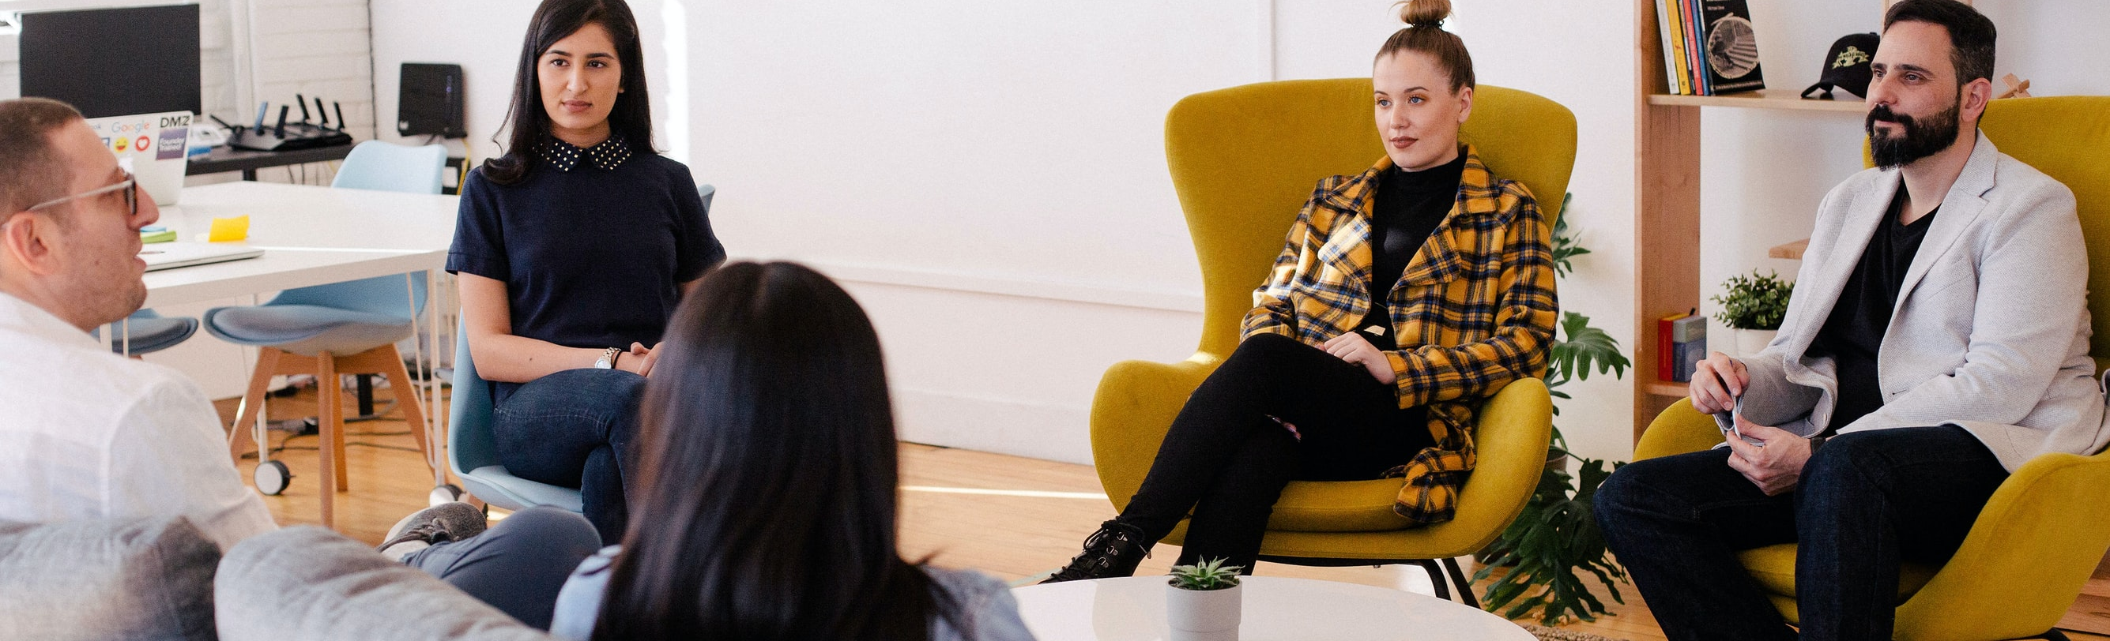
Soliciting Requirements
Option 2: Direct research
Interview users, ask questions about their problems, propose potential solutions, examine those solutions
Embed your client in your design team, or better yet, become an anthropologist in your client’s environment
Build requirements documents that demonstrate your understanding of the requirements, iterate
Empowers your team with credibility and authority
Notes:
Needfinding broadly describes a form of design research where we use qualitative methods to understand what product is needed. Product design research is quite literally the topic of another class, so we won’t go too far into depth here, other than to be sure that you are aware of its existence and its benefits
Kinds of qualitative data that you can gather:
behaviors, attitudes, aptitudes of potential and existing users
technical, business, and environmental contexts - domain
vocabulary and social aspects of domain how existing products are used
In addition to helping drive requirements, this can also empower your team with more credibility + authority when working with client, helping inform decisions while making a better product
Note – market research (who are our users, and what factors would influence their adoption of our product?) is yet another topic for yet another course, and probably shouldn’t be mentioned at all

Slide 9
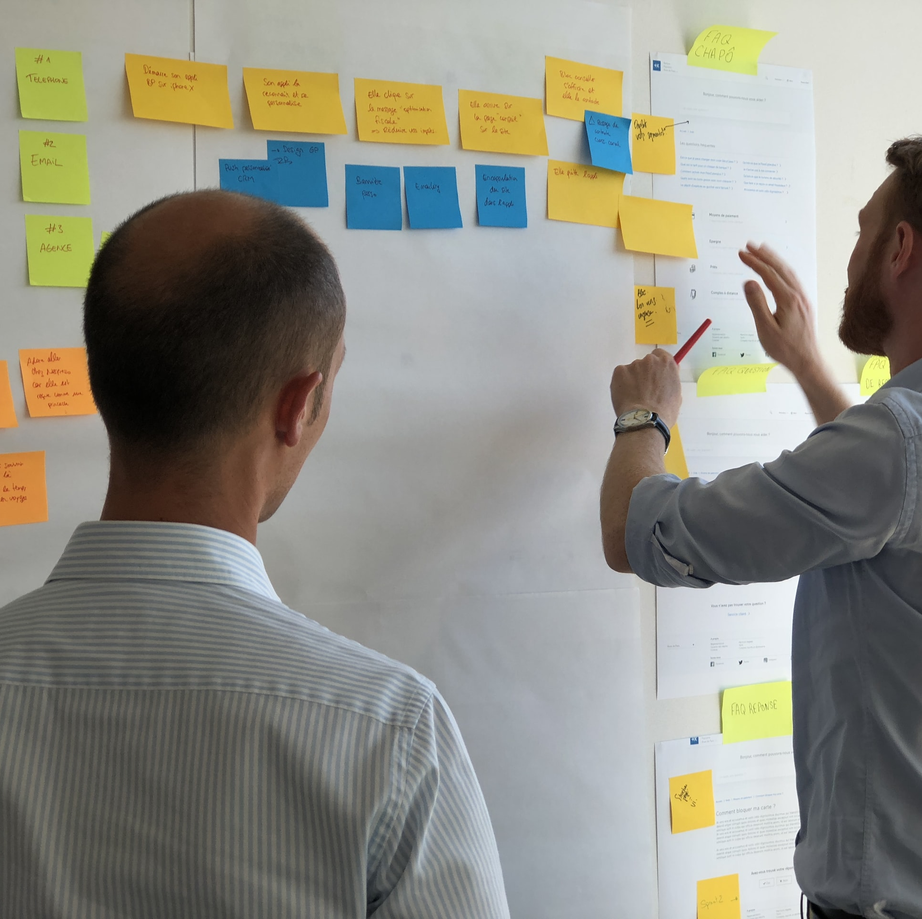
Addressing Problems of Understanding: Documentation
Documentation helps our whole team make sure they are building the right thing
Documentation can help specify implicit requirements
Documentation can also serve as an artifact to iterate on with a client
Notes:
Whatever combination of methods we choose to solict our requirements, we probably need to document them somehow. Having documented requirements can certainly help make sure that the whole team is on board with what is being made, and to try to minimize having things “lost in translation” – you have something to look back on and say “did I make the thing I said I would make”
It’s very important for our requirements documentation to include non-functional requirements, too, which might otherwise be implicit (unspoken)
This documentation can also serve as a point of reference for us to iterate with a customer, refining the requirements, and ensuring that all stakeholders agree on their completeness/correctness.
There are a lot of options for how to do this…

Slide 10
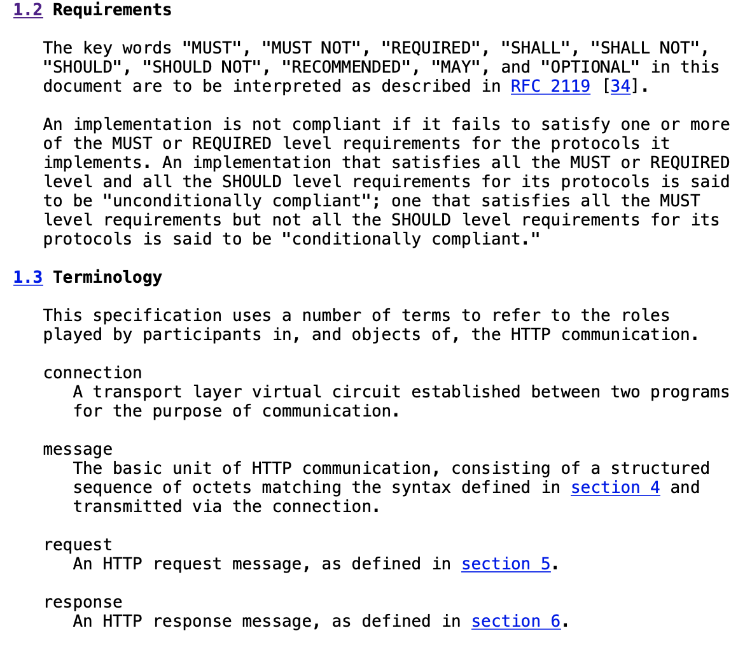
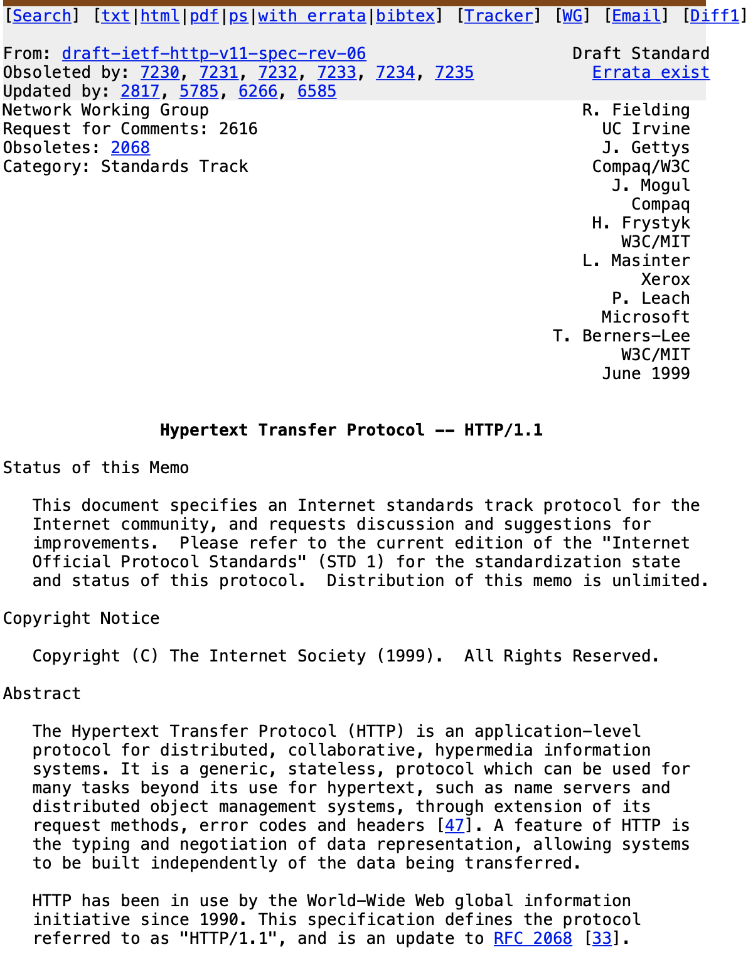
Documenting Requirements: Specifications
Define all expected behaviors under all expected conditions
Notes:
One way to specify requirements is with a formal specification. That is, you specify all possible inputs and all expected outputs and side effects.
Here is an example of the specification for HTTP. You can tell that it is “formal” because it includes a definitions section that goes so far as to clarify the usage of the term “MUST” or “SHOULD”, plus domain-specific terms like “connection” and “message”. The specification aims to have no ambiguities, whatsoever.
Ask class: When would such a specification be desirable?
Examples:
Well, obviously for HTTP (on the slide), and similarly for other protocols that require interoperability: want to make sure that a different team can implement a browser from a server from a caching proxy or content filter
Safety-critical systems (someone’s life is at risk; want to have formal review of formal specs)

Slide 11
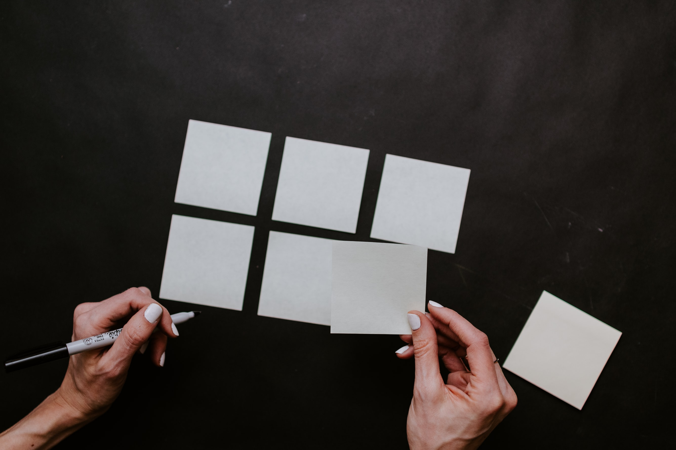
Documenting Requirements: User Stories
Specifying what should happen, for who, and why
As a <role> I can <capability>, so that <receive benefit>
Notes:
User stories are another approach for documenting requirements, which are structured to put the user first. A user story is a short simple description of ONE feature that can fit on a 3x5” card, written in the user’s language.
Why do we focus on the value? Because ultimately our goal with building software is presumably to deliver value – do something that helps some user accomplish some goal. That “something of value” is really what the requirement is. The customer probably doesn’t care to define every possible output for their system for every possible input – instead they just want to tell you what they want to have happen, in language that is as close to their own as possible.
Not called “customer” stories, they are “user stories”. You might develop software for a self-driving car, and your customer is Tesla. But your users is Tesla’s customer. User stories force both you and your customer to focus on your user, who is presumably the one who wants to extract value from your software
“Role” lets us distinguish between the different ways that our software might be used: Canvas is used by both instructors and students. However, there are even more roles, which have different capabilities: TAs can also view grades, but they can’t add new Tas. “Course observers” can see course content, but not grades, and are not enrolled in the class. There are quite a few different roles in Canvas, and maybe you can see how it would help to organize features in that way.
What makes a good user story?

Slide 12
Writing User Stories: INVEST
Independent
Negotiable
Valuable
Estimable
Small
Testable
As a <role> I can <capability>, so that <receive benefit>
Notes:
Popular mnemonic for describing what makes a good user story
Independent – Stories should not be coupled between each other, except where obviously necessary. Want to make it so that a user can examine a story on its own
Negotiable – Best stories are result of a negotiation between a client and a developer – how do we come to some utual agreement about what we are going to build, and why? Goal is to develop what the customer needs
Valuable – Each story should have some benefit that the user can recognize. Value might include value to your business, not just value to the user.
Estimable – As we will see in a bit, being able to estimate how long it will take to implement a user story is key to determining a reasonable scope for your project
Small – A rule of thumb is to average 3-4 days of work per-story. Again, we’ll see this fit in with estimation.
Testable – There must be some way to judge completion: for the person implementing the software, and for the end-user.
https://agileforall.com/new-to-agile-invest-in-good-user-stories/
… Let’s see an example and work through some of the tricky bits

Slide 13
User Stories: Example – Backup Software
As a computer user, I want to backup my entire hard drive so that my files are safe
As a typical computer user, I want to specify folders to backup, so that my most important files are safe
As a power user, I want to specify subfolders and filetypes NOT to backup, so that my backup doesn’t fill up with things that I don’t need to preserve

Slide 14
User Stories: Conditions of Satisfaction
How do we know if we have satisfied the user? Lots of detail doesn’t fit onto 3x5 card:
Where do backups get saved?
What if backup system is unavailable?
What if backup system is full?
Do backups ever get rotated/deleted?
Conditions of satisfaction are a list of common cases and special cases that must work
Notes:
Discuss these potential special cases, can do brainstorming to get some ideas going about what conditions of satisfaction are for backups

Slide 15
Conditions of Satisfaction: Backup Software
“As a typical computer user, I want to specify folders to backup, so that my most important files are safe”
My conditions of satisfaction are:
If the network and remote backup service are available, and I am not over my storage quota, the backup should be successful.
After successfully running, an updated copy of each of the files that I have requested to be backed up are stored in a redundant, cloud filesystem
If a backup is not successful, an error message is prominently displayed indicating the cause of failure to be in the software, the network, the remote backup storage, or other
Notes:
Conditions of satisfaction are, effectively, test cases – or templates for test cases. These kinds of tests are sometimes called “acceptance tests” because they constitute the end-user accepting that your software does what they want. Cool!
They are usually much more lengthy than user stories, and are stored elsewhere (particularly if you are using 3x5” cards!), maybe in a project management tool
Discuss conditions of satisfaction. Do students think these are clear? Will we end up with a system that we are satisfied with?

Slide 16
Non-Functional Requirements: Backup Software
Does “After successfully running, an updated copy of each of the files that I have requested to be backed up are stored in a redundant, cloud filesystem” guarantee success?
What was the transfer speed? (Performance)
How much temporary disk space did it use to create the backup? (Performance)
How long did I spend on the phone with support to set up the software? (Usability)
Are my files encrypted, or access controlled at all? (Security)
Notes:
“Can I retrieve my files, and if so, how long will it take?” is probably another use case

Slide 17
Common Non-Functional Requirements
Qualities that reflect the execution of the system
Accessibility
Availability
Capacity
Efficiency
Performance
Privacy
Response Time
Security
Supportability
Usability
Example: “A 4-core server with 16 GB RAM should be able to service at least 200 simultaneous clients with less than 300ms latency”
Notes:
Non-functional requirements capture the quality goals of a system. As we saw in this backups example, the product that you end up building might satisfy the functional requirements, while resulting in something that is totally useless as a backup system, because you didn’t realize that backed up files shouldn’t be listed publicly on the internet – oops,I guess that should have been documented in the requirements.
Here is a partial list of some quality goals, or non-functional requirements that you might need to consider on a project. Note that this is only a partial list, but we included some examples to demonstrate how precise you can be.
For example, one high-level goal is to say “I want performance”. But what does performance mean? You probably mean to say that you expect that the system has some particular capacity (in terms of simultaneous users), who can simultaneously have their requests satisfied within some response time. That’s still not the whole picture though, because you didn’t specify the efficiency of your system: what hardware resources does it use to achieve that performance?

Slide 18
Common Non-Functional Requirements
Qualities that reflect the evolution of the system
Testability
Maintainability
Extensibility
Scalability
Example: “A 3rd party component built conforming to the API defined in XYZ can interface with the backup system and access files on behalf of a user”
Notes:
Non-functional requirements might also impact the static existence of the system, or its evolution.
For example, if a customer intends for your software to be particularly long-lasting, and to be able to be extended – this needs to be said. Similarly, if there are specific testing requirements that your customer needs to comply with, there may be testability requirements, that define the effort needed to test the behaviors of that system.

Slide 19
Requirements: Which to pick?
There are four knobs you can adjust when negotiating requirements:
Project scope
Project duration
Project quality
Project cost
Usually cost is most constrained: you have a budget to spend, and you have a headcount of developers to pay
Determining feasible scope, timeline and maximizing quality is the subject of much software engineering research, see next lesson

